Slide 1

Predictable Workflow VS Dynamic Agent
AI DevOps Agent

Slide 2
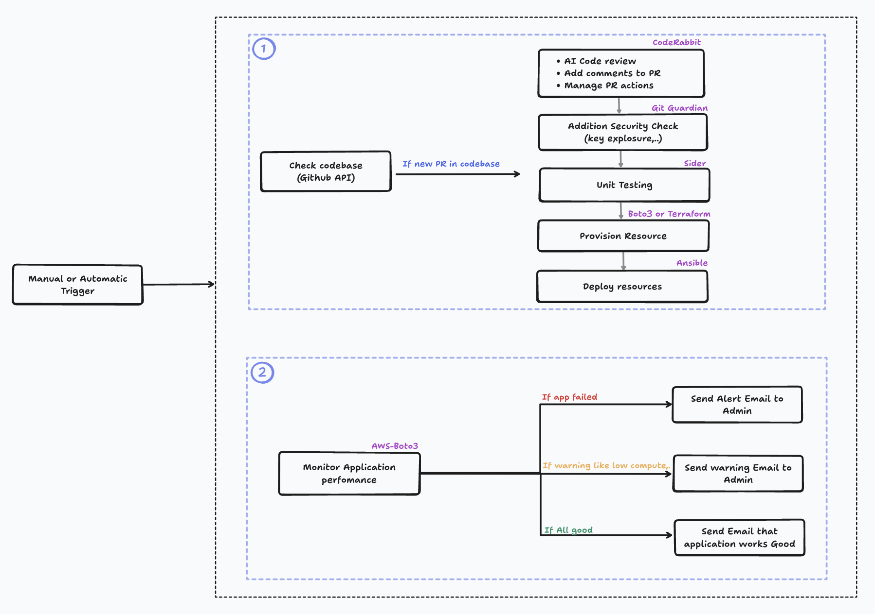
Workflow Design

Slide 3
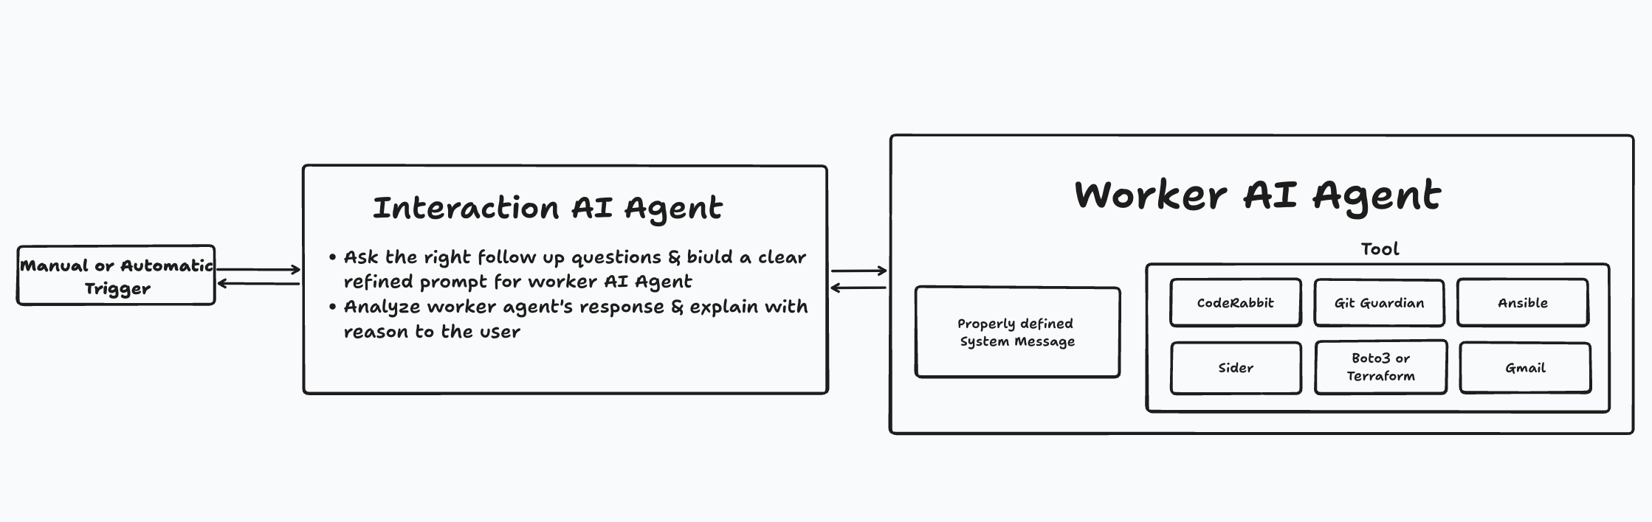
Agent Design

Slide 4
Workflow vs Agent
Pros of Workflow
Pros of Agent
Ordered execution, easy to debug in the execution
Faster execution with lower compute cost
Clear separation of CI/CD, security, testing, and monitoring
Easier compliance and auditing
Low-cost implementation
Can make decisions dynamically (e.g., skip tests, retry deploy)
Adapts to new PR patterns, failures, or infra changes
Can reason across code review, security, infra, and monitoring
Reduces manual intervention over time
Better for complex, evolving systems
Cons of Workflow
Cons of Workflow
Rigid flow (complex to implement for new scenarios)
Requires manual updates for new tools or steps
Cannot alter or optimize beyond predefined logic
Limited decision-making (mostly if/else rules)
Harder to debug and explain decisions
Higher compute and operational cost
Requires strong guardrails to avoid unsafe actions
Risk of unintended changes (over-autonomy)
More complex security and access control
Prefer Workflow
Prefer Workflow
Stable and well-defined structure
Small to medium systems with predictable changes
For repeated & deterministic executions
When cost optimization requires
For complex & large codebase where cost doesn’t matter
Where system requires dynamic plans to be executed
Retrying automatically on failures

Slide 5

Thank You
Kaviraj A
kaviraja@presidio.com

